Slide 1

Battle of Neighborhoods
Analysing Oxford Area for Property Investment

Slide 2
Project Agenda
Introduction to the Project
Background
Business Problem
Workflow
Summary of the Project results

Slide 3
Introduction
Battle of Neighbourhoods is the final project for Applied Data Science Capstone Course
We will use Data Science workflow to analyse the area and suggest the most appropriate neighbourhood for property investment

Slide 4
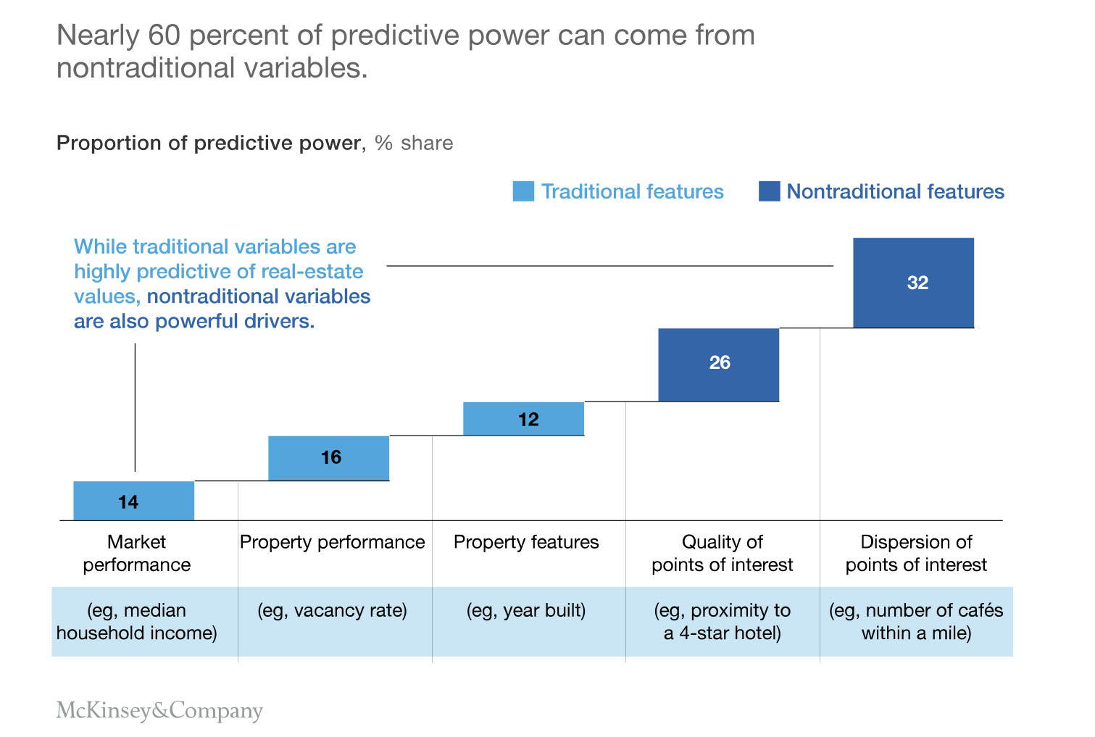
Background
Housing market slowing down due to pandemic
Prices will drop as per prognosis and low activity
Good time to invest into property
Oxford is a busy university city where properties are in demand
Up to 60% of property performance depends on non-traditional features
Housing prices to grow back after pandemic is over

Slide 5
Business Problem
Covid -19 pandemic and lockdown
Not possible to move around and explore the area
People will be interested in the property market after lockdown lifted

Slide 6
Workflow
Data collection
Data inspection and understanding
Data preparation and processing
Data modelling using k-Nearest Neighbour Algorithm
Visualization and Discussion
Summary of the project results

Slide 7
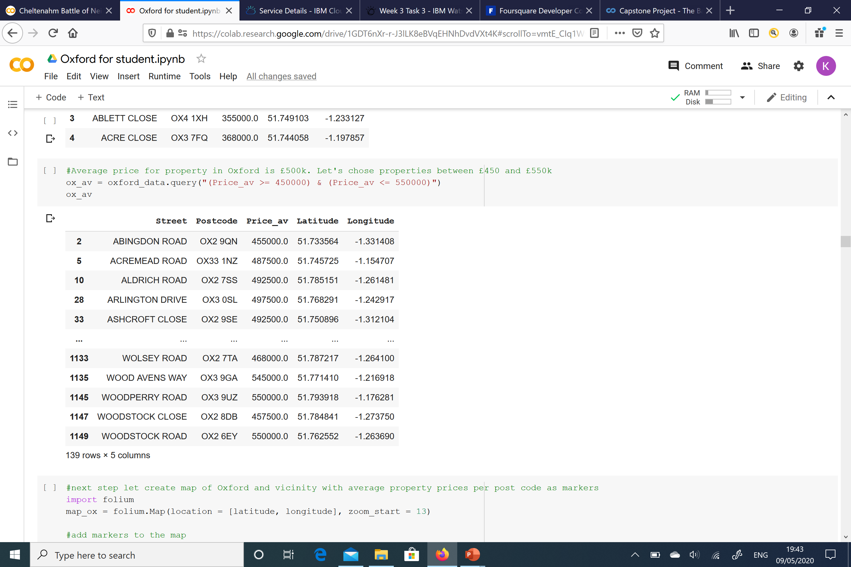
Data collection, inspection, preparation and processing
Property Data downloaded from HM Land Registry
Postcodes coordinates downloaded from open source
Venues downloaded from FourSquare API
All data were cleaned and arranged into Pandas data frames

Slide 8
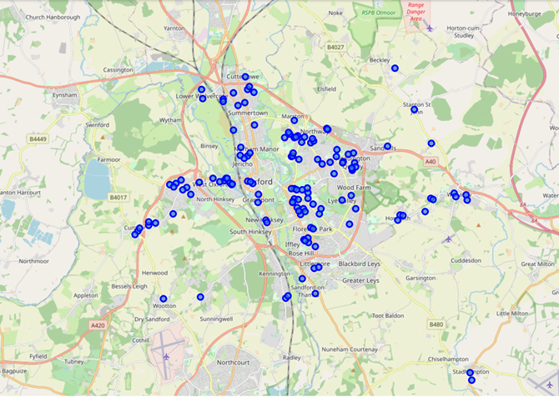
Oxford housing prices
Average housing price for Oxford is £500k
The housing prices were chosen in the range between £450k and £550k
From the map created we can see that properties within average price range evenly spread in the city

Slide 9
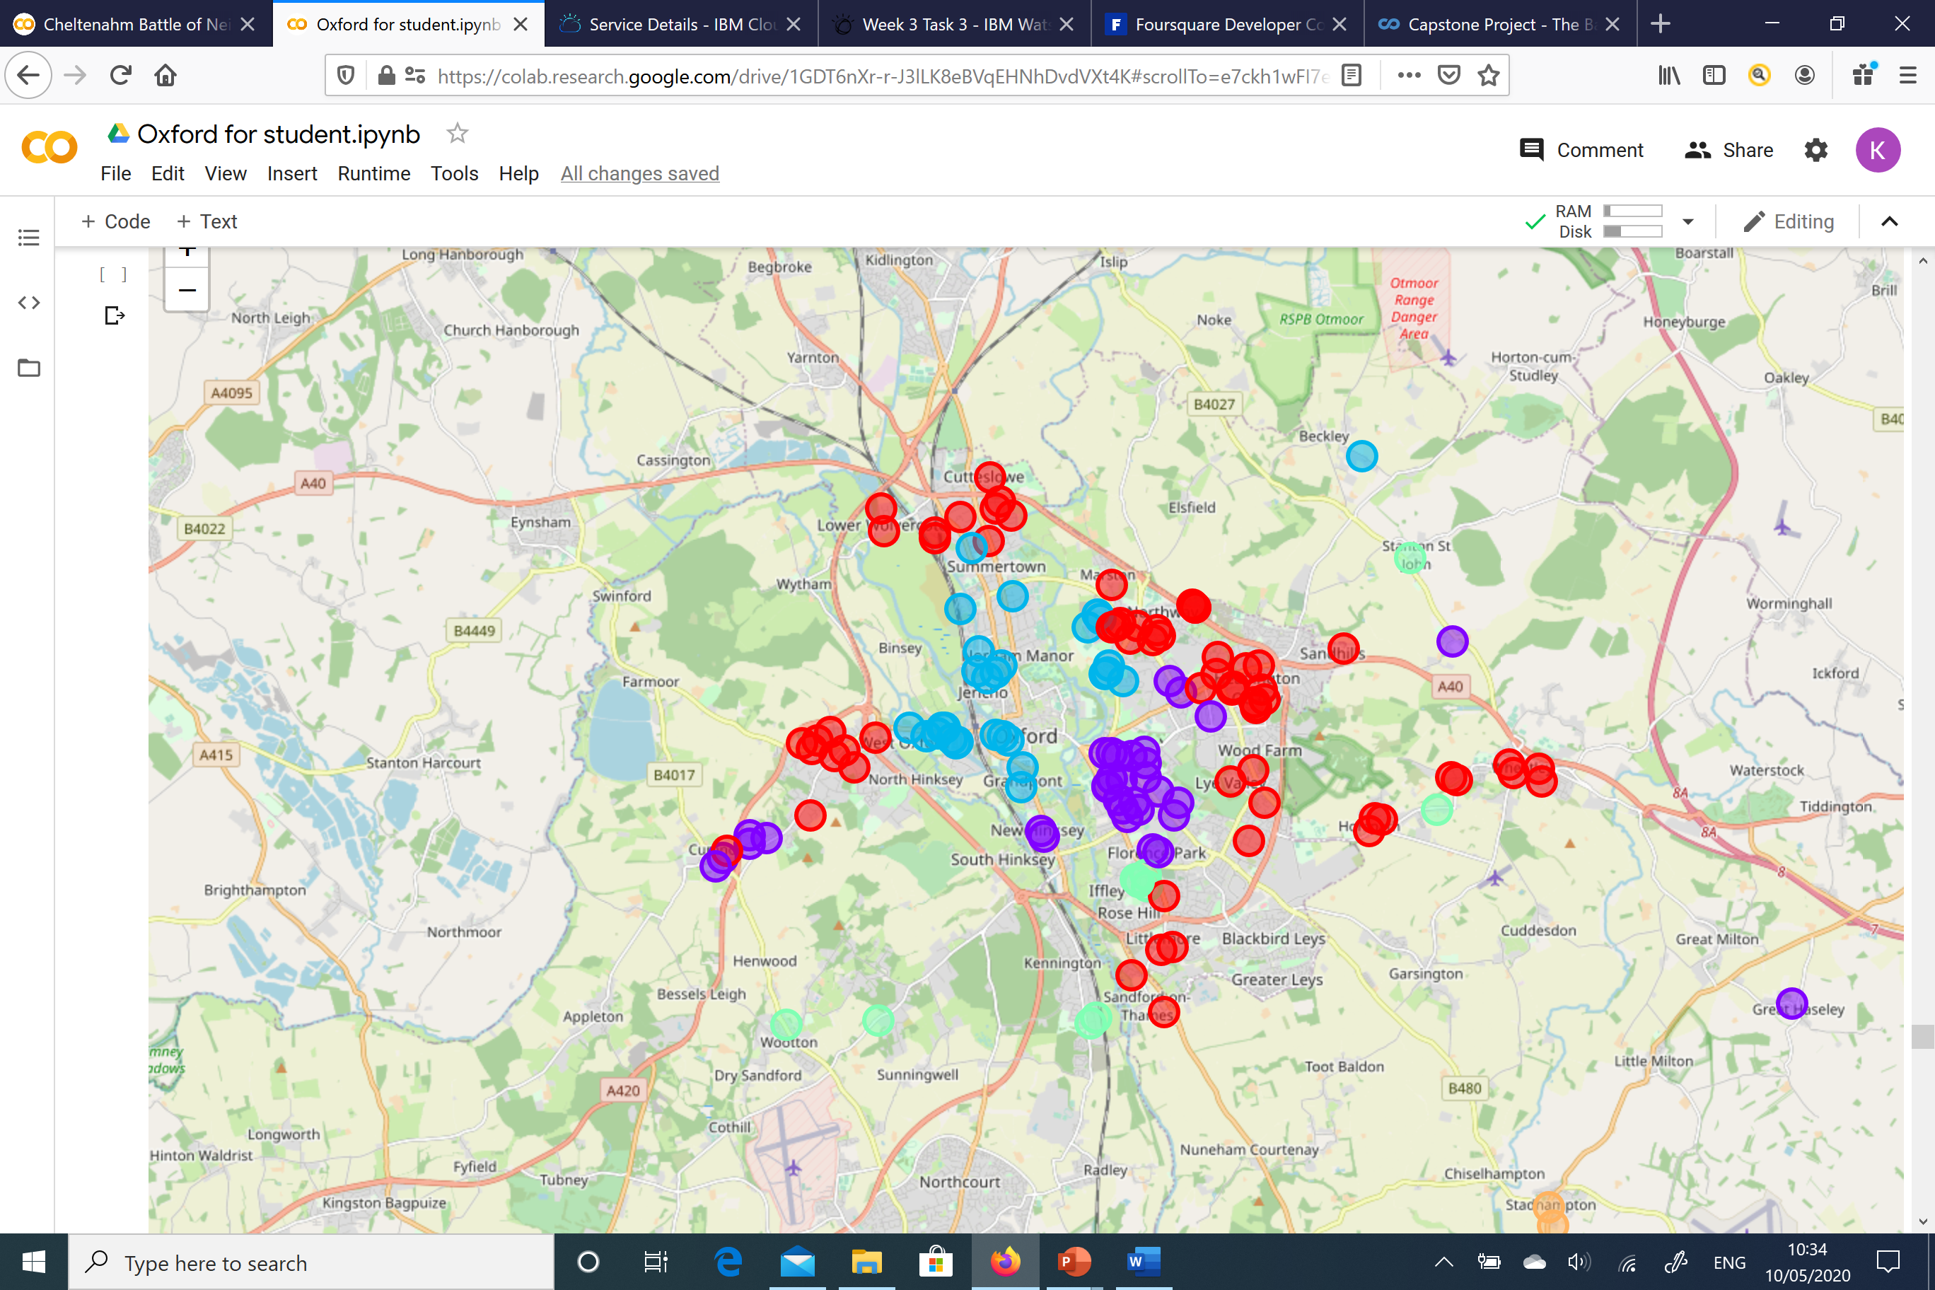
Modelling – k-Nearest Neighbours
k-Nearest Neighbours Algorithm was used to find similarities between Oxford Locations
We defined 5 clusters for Oxford area
To visualise our research we created the cluster map for the most common venues

Slide 10
Discussion
Cluster 1 has plenty of grocery stores and supermarkets, parks, hotels, restaurants bus station and the shopping mall.
Cluster 2 has a lot of restaurants/cafes, museums, historic site, bus stops and karting.
Cluster 3 has museums, restaurants, the Canal, coffee shops and book store.
Cluster 4 has a grocery stores, some hotels, gym, a few number of restaurants and no parks or green area.
Cluster 5 is a remote location with a limited number of venues.
Cluster 1&2 have more diverse venues and are more attractive for property search

Slide 11
Conclusion
Good time for investment on property market due to slow down.
Long time to explore the area by foot, impossible during lock down.
Data science methodology to cluster the area of Oxford city to define the most attractive locations for the investment.
The data used public HM Land Registry data base.
FourSquare API was used to define most common amenities/venues.
The workflow of exploring the data, understanding it, pre-processing and processing to create Pandas data frames.
k-Nearest Neighbours algorithm to find the similarities of the properties locations and created 5 clusters.
Visualized the area in terms of average property price distribution and cluster spread by creating the maps.
Examination showed that cluster 1 and 2 are most attractive for the investor as they have most diverse venues.

